Slide 1
Introduction to cloud computing
Jiaheng Lu
Department of Computer Science
Renmin University of China
www.jiahenglu.net

Slide 2
Overview
Hadoop Technical Walkthrough
HDFS
Databases
Using Hadoop in an Academic Environment
Performance tips and other tools

Slide 3
Google calls it: | Hadoop equivalent:
MapReduce | Hadoop
GFS | HDFS
Bigtable | HBase
Chubby | Zookeeper

Slide 4
Some MapReduce Terminology
Job – A “full program” - an execution of a Mapper and Reducer across a data set
Task – An execution of a Mapper or a Reducer on a slice of data
  a.k.a. Task-In-Progress (TIP)
Task Attempt – A particular instance of an attempt to execute a task on a machine

Slide 5
Terminology Example
Running “Word Count” across 20 files is one job
20 files to be mapped imply 20 map tasks + some number of reduce tasks
At least 20 map task attempts will be performed… more if a machine crashes, etc.

Slide 6
Task Attempts
A particular task will be attempted at least once, possibly more times if it crashes
  If the same input causes crashes over and over, that input will eventually be abandoned
Multiple attempts at one task may occur in parallel with speculative execution turned on
  Task ID from TaskInProgress is not a unique identifier; don’t use it that way

Slide 7
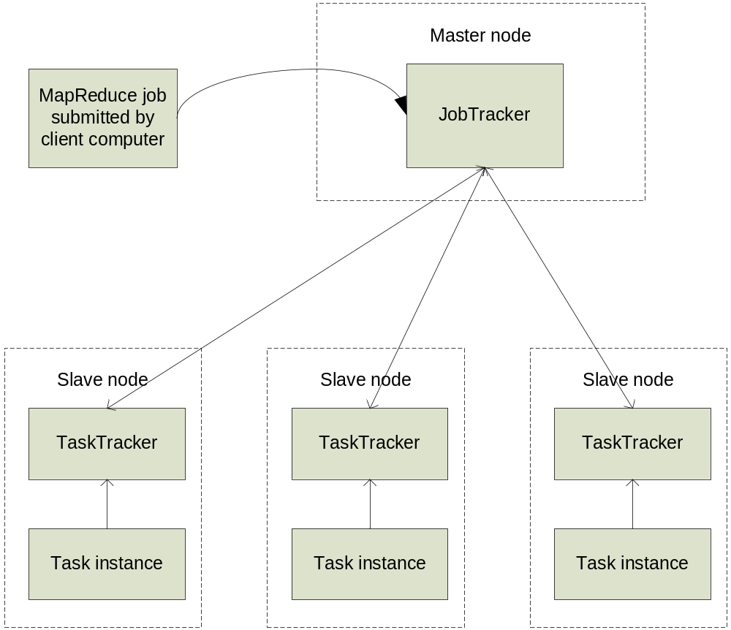
MapReduce: High Level

Slide 8
Node-to-Node Communication
Hadoop uses its own RPC protocol
All communication begins in slave nodes
  Prevents circular-wait deadlock
  Slaves periodically poll for “status” message
Classes must provide explicit serialization

Slide 9
Nodes, Trackers, Tasks
Master node runs JobTracker instance, which accepts Job requests from clients
TaskTracker instances run on slave nodes
TaskTracker forks separate Java process for task instances

Slide 10
Job Distribution
MapReduce programs are contained in a Java “jar” file + an XML file containing serialized program configuration options
Running a MapReduce job places these files into the HDFS and notifies TaskTrackers where to retrieve the relevant program code
… Where’s the data distribution?

Slide 11
Data Distribution
Implicit in design of MapReduce!
  All mappers are equivalent; so map whatever data is local to a particular node in HDFS
If lots of data does happen to pile up on the same node, nearby nodes will map instead
  Data transfer is handled implicitly by HDFS

Slide 12
Configuring With JobConf
MR Programs have many configurable options
JobConf objects hold (key, value) components mapping String → ’a
  e.g., “mapred.map.tasks” → 20
  JobConf is serialized and distributed before running the job
Objects implementing JobConfigurable can retrieve elements from a JobConf

Slide 13
What Happens In MapReduce?
Depth First

Slide 14
Job Launch Process: Client
Client program creates a JobConf
  Identify classes implementing Mapper and Reducer interfaces
    JobConf.setMapperClass(), setReducerClass()
  Specify inputs, outputs
    JobConf.setInputPath(), setOutputPath()
  Optionally, other options too:
    JobConf.setNumReduceTasks(), JobConf.setOutputFormat()…

Slide 15
Job Launch Process: JobClient
Pass JobConf to JobClient.runJob() or submitJob()
  runJob() blocks, submitJob() does not
JobClient:
  Determines proper division of input into InputSplits
  Sends job data to master JobTracker server

Slide 16
Job Launch Process: JobTracker
JobTracker:
  Inserts jar and JobConf (serialized to XML) in shared location
  Posts a JobInProgress to its run queue

Slide 17
Job Launch Process: TaskTracker
TaskTrackers running on slave nodes periodically query JobTracker for work
Retrieve job-specific jar and config
Launch task in separate instance of Java
  main() is provided by Hadoop

Slide 18
Job Launch Process: Task
TaskTracker.Child.main():
  Sets up the child TaskInProgress attempt
  Reads XML configuration
  Connects back to necessary MapReduce components via RPC
  Uses TaskRunner to launch user process

Slide 19
Job Launch Process: TaskRunner
TaskRunner, MapTaskRunner, MapRunner work in a daisy-chain to launch your Mapper
  Task knows ahead of time which InputSplits it should be mapping
  Calls Mapper once for each record retrieved from the InputSplit
Running the Reducer is much the same

Slide 20
Creating the Mapper
You provide the instance of Mapper
  Should extend MapReduceBase
One instance of your Mapper is initialized by the MapTaskRunner for a TaskInProgress
  Exists in separate process from all other instances of Mapper – no data sharing!

Slide 21
Mapper
void map(WritableComparable key,
  Writable value,
  OutputCollector output,
  Reporter reporter)

Slide 22
What is Writable?
Hadoop defines its own “box” classes for strings (Text), integers (IntWritable), etc.
All values are instances of Writable
All keys are instances of WritableComparable

Slide 23
Writing For Cache Coherency
while (more input exists) {
myIntermediate = new intermediate(input);
myIntermediate.process();
export outputs;
}

Slide 24
Writing For Cache Coherency
myIntermediate = new intermediate (junk);
while (more input exists) {
myIntermediate.setupState(input);
myIntermediate.process();
export outputs;
}

Slide 25
Writing For Cache Coherency
Running the GC takes time
Reusing locations allows better cache usage
Speedup can be as much as two-fold
All serializable types must be Writable anyway, so make use of the interface

Slide 26
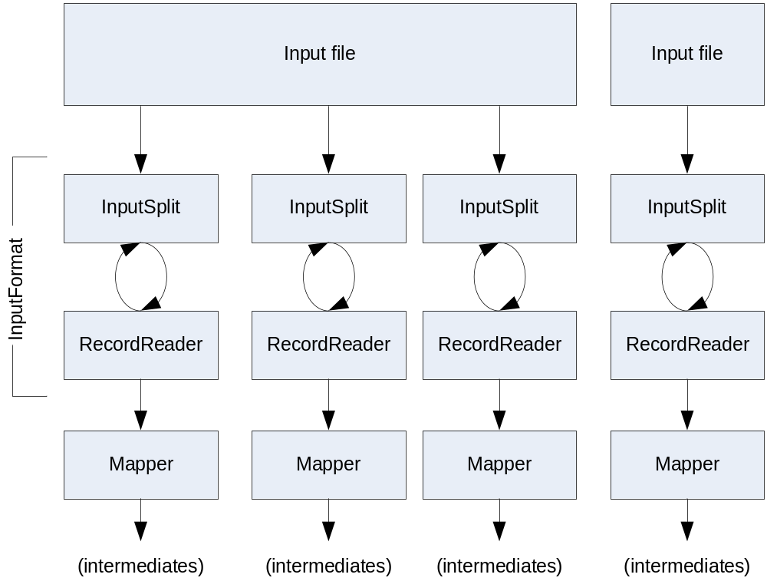
Getting Data To The Mapper

Slide 27
Reading Data
Data sets are specified by InputFormats
  Defines input data (e.g., a directory)
  Identifies partitions of the data that form an InputSplit
  Factory for RecordReader objects to extract (k, v) records from the input source

Slide 28
FileInputFormat and Friends
TextInputFormat – Treats each ‘\n’-terminated line of a file as a value
KeyValueTextInputFormat – Maps ‘\n’- terminated text lines of “k SEP v”
SequenceFileInputFormat – Binary file of (k, v) pairs with some add’l metadata
SequenceFileAsTextInputFormat – Same, but maps (k.toString(), v.toString())

Slide 29
Filtering File Inputs
FileInputFormat will read all files out of a specified directory and send them to the mapper
Delegates filtering this file list to a method subclasses may override
  e.g., Create your own “xyzFileInputFormat” to read *.xyz from directory list

Slide 30
Record Readers
Each InputFormat provides its own RecordReader implementation
  Provides (unused?) capability multiplexing
LineRecordReader – Reads a line from a text file
KeyValueRecordReader – Used by KeyValueTextInputFormat

Slide 31
Input Split Size
FileInputFormat will divide large files into chunks
  Exact size controlled by mapred.min.split.size
RecordReaders receive file, offset, and length of chunk
Custom InputFormat implementations may override split size – e.g., “NeverChunkFile”

Slide 32
Sending Data To Reducers
Map function receives OutputCollector object
  OutputCollector.collect() takes (k, v) elements
Any (WritableComparable, Writable) can be used

Slide 33
WritableComparator
Compares WritableComparable data
  Will call WritableComparable.compare()
  Can provide fast path for serialized data
JobConf.setOutputValueGroupingComparator()

Slide 34
Sending Data To The Client
Reporter object sent to Mapper allows simple asynchronous feedback
  incrCounter(Enum key, long amount)
  setStatus(String msg)
Allows self-identification of input
  InputSplit getInputSplit()

Slide 35
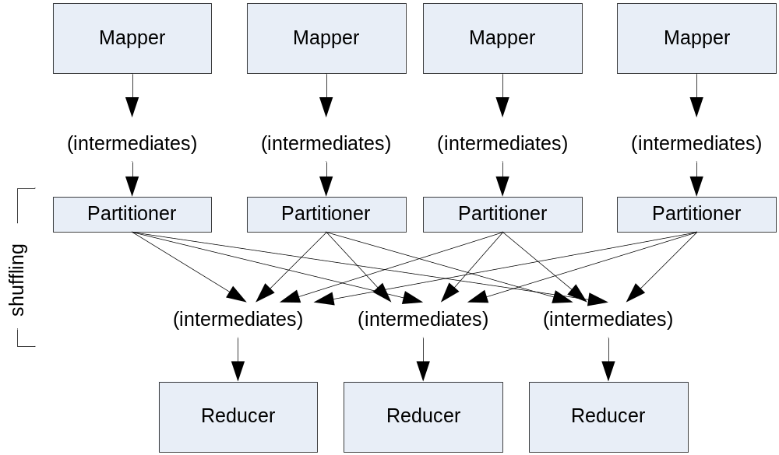
Partition And Shuffle

Slide 36
Partitioner
int getPartition(key, val, numPartitions)
  Outputs the partition number for a given key
  One partition == values sent to one Reduce task
HashPartitioner used by default
  Uses key.hashCode() to return partition num
JobConf sets Partitioner implementation

Slide 37
Reduction
reduce( WritableComparable key,
  Iterator values,
  OutputCollector output,
  Reporter reporter)
Keys & values sent to one partition all go to the same reduce task
Calls are sorted by key – “earlier” keys are reduced and output before “later” keys

Slide 38
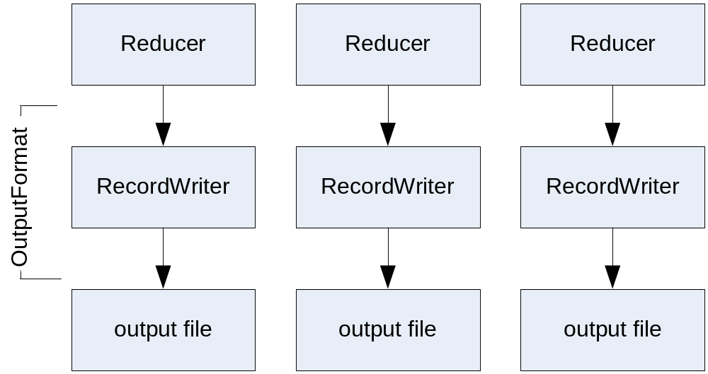
Finally: Writing The Output

Slide 39
OutputFormat
Analogous to InputFormat
TextOutputFormat – Writes “key val\n” strings to output file
SequenceFileOutputFormat – Uses a binary format to pack (k, v) pairs
NullOutputFormat – Discards output

Slide 40
HDFS

Slide 41
HDFS Limitations
“Almost” GFS
  No file update options (record append, etc); all files are write-once
Does not implement demand replication
Designed for streaming
  Random seeks devastate performance

Slide 42
NameNode
“Head” interface to HDFS cluster
Records all global metadata

Slide 43
Secondary NameNode
Not a failover NameNode!
Records metadata snapshots from “real” NameNode
  Can merge update logs in flight
  Can upload snapshot back to primary

Slide 44
NameNode Death
No new requests can be served while NameNode is down
  Secondary will not fail over as new primary
So why have a secondary at all?

Slide 45
NameNode Death, cont’d
If NameNode dies from software glitch, just reboot
But if machine is hosed, metadata for cluster is irretrievable!

Slide 46
Bringing the Cluster Back
If original NameNode can be restored, secondary can re-establish the most current metadata snapshot
If not, create a new NameNode, use secondary to copy metadata to new primary, restart whole cluster ( ☹ )
Is there another way…?

Slide 47
Keeping the Cluster Up
Problem: DataNodes “fix” the address of the NameNode in memory, can’t switch in flight
Solution: Bring new NameNode up, but use DNS to make cluster believe it’s the original one

Slide 48
Further Reliability Measures
Namenode can output multiple copies of metadata files to different directories
  Including an NFS mounted one
  May degrade performance; watch for NFS locks

Slide 49
Databases

Slide 50
Life After GFS
Straight GFS files are not the only storage option
HBase (on top of GFS) provides column-oriented storage
mySQL and other db engines still relevant

Slide 51
HBase
Can interface directly with Hadoop
Provides its own Input- and OutputFormat classes; sends rows directly to mapper, receives new rows from reducer
… But might not be ready for classroom use (least stable component)

Slide 52
MySQL Clustering
MySQL database can be sharded on multiple servers
  For fast IO, use same machines as Hadoop
Tables can be split across machines by row key range
  Multiple replicas can serve same table

Slide 53
Sharding & Hadoop Partitioners
For best performance, Reducer should go straight to local mysql instance
  Get all data in the right machine in one copy
Implement custom Partitioner to ensure particular key range goes to mysql-aware Reducer

Slide 54
Academic Hadoop Requirements

Slide 55
Server Profile
UW cluster:
  40 nodes, 80 processors total
  2 GB ram / processor
  24 TB raw storage space (8 TB replicated)
One node reserved for JobTracker/NameNode
Two more wouldn’t cooperate
… But still vastly overpowered

Slide 56
Standard Hardware Profiles
All hardware profiles are data-driven
1–4 disks
  ~500 GB each
  SATA or SATA2
  7200 RPM
2 CPU cores/disk (~1.8–2.0 GHz)
1–2 GB RAM/core
Gigabit Ethernet (1 interface/machine)

Slide 57
Setup & Maintenance
Took about two days to setup and configure
  Mostly hardware-related issues
  Hadoop setup was only a couple hours
Maintenance: only a few hours/week
  Mostly rebooting the cluster when jobs got stuck

Slide 58
Total Usage
About 15,000 CPU-hours consumed by 20 students
… Out of 130,000 available over quarter
Average load is about 12%

Slide 59
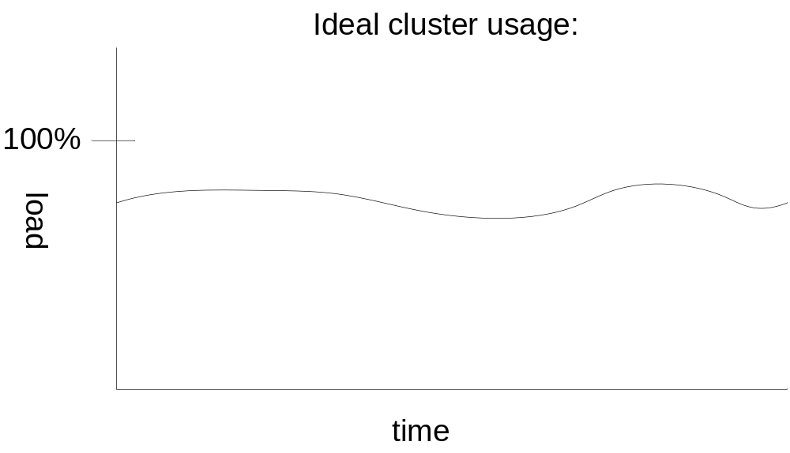
Analyzing student usage patterns

Slide 60
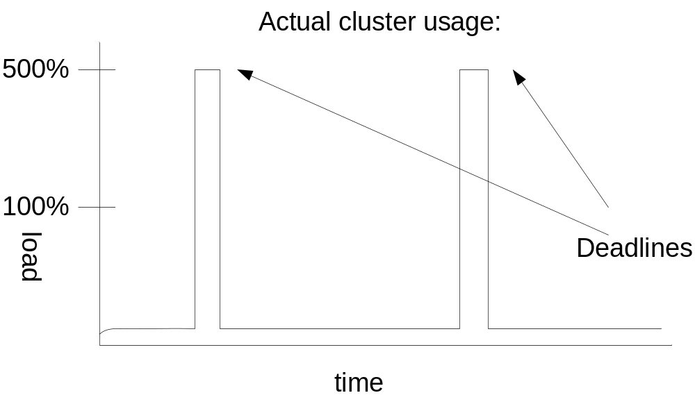
Analyzing student usage patterns
Lesson: Resource demands are NOT constant!

Slide 61
Hadoop Job Scheduling
FIFO queue matches incoming jobs to available nodes
  No notion of fairness
  Never switches out running job
  Run-away tasks could starve other student jobs

Slide 62
Hadoop Security
But on the bright (?) side:
  No security system for jobs
  Anyone can start a job; but they can also cancel other jobs
Realistically, students did not cancel other student jobs, even when they should

Slide 63
Hadoop Security: The Dark Side
No permissions in HDFS either
  Now included in 0.16.1+
One student deleted the common data set for a project
  Email subject: “Oops…”
  No students could test their code until data set restored from backup

Slide 64
Job Scheduling Lessons
Getting students to “play nice” is hard
  No incentive
  Just plain bad/buggy code
Cluster contention caused problems at deadlines
  Work in groups
  Stagger deadlines

Slide 65
Another Possibility
Amazon EC2 provides on-demand servers
May be able to have students use these for jobs
  “Lab fees…”
  Simple web-based interfaces exist

Slide 66
Best Use of University Machines
Partition machines into clusters of 8—10 nodes
Each cluster can support 5—8 students
Possibly using common DFS across all clusters

Slide 67
More Performance & Scalability

Slide 68
Configuring for Performance
Configuring Hadoop performed in “base JobConf” in conf/hadoop-site.xml
Contains 3 different categories of settings
  Settings that make Hadoop work
  Settings for performance
  Optional flags/bells & whistles

Slide 69
Making Hadoop Work
Basic configuration involves pointing nodes at master machines
  mapred.job.tracker
  fs.default.name
  dfs.data.dir, dfs.name.dir
  hadoop.tmp.dir
  mapred.system.dir
See “Hadoop Quickstart” in online documentation

Slide 70
Configuring for Performance
mapred.child.java.opts | -Xmx512m
dfs.block.size | 134217728
mapred.reduce.parallel.copies | 20—50
dfs.datanode.du.reserved | 1073741824
io.sort.factor | 100
io.file.buffer.size | 32K—128K
io.sort.mb | 20--200
tasktracker.http.threads | 40—50

Slide 71
Number of Tasks
Controlled by two parameters:
  mapred.tasktracker.map.tasks.maximum
  mapred.tasktracker.reduce.tasks.maximum
Two degrees of freedom in mapper run time: Number of tasks/node, and size of InputSplits
Current conventional wisdom: 2 map tasks/core, less for reducers
See http://wiki.apache.org/lucene-hadoop/HowManyMapsAndReduces

Slide 72
Dead Tasks
Student jobs would “run away”, admin restart needed
Very often stuck in huge shuffle process
  Students did not know about Partitioner class, may have had non-uniform distribution
  Did not use many Reducer tasks
  Lesson: Design algorithms to use Combiners where possible

Slide 73
Working With the Scheduler
Remember: Hadoop has a FIFO job scheduler
  No notion of fairness, round-robin
Design your tasks to “play well” with one another
  Decompose long tasks into several smaller ones which can be interleaved at Job level

Slide 74
Additional Languages & Components

Slide 75
Hadoop and C++
Hadoop Pipes
  Library of bindings for native C++ code
  Operates over local socket connection
Straight computation performance may be faster
Downside: Kernel involvement and context switches

Slide 76
Hadoop and Python
Option 1: Use Jython
  Caveat: Jython is a subset of full Python
Option 2: HadoopStreaming

Slide 77
HadoopStreaming
Effectively allows shell pipe ‘|’ operator to be used with Hadoop
You specify two programs for map and reduce
  (+) stdin and stdout do the rest
  (-) Requires serialization to text, context switches…
  (+) Reuse Linux tools: “cat | grep | sort | uniq”

Slide 78
Eclipse Plugin
Support for Hadoop in Eclipse IDE
  Allows MapReduce job dispatch
  Panel tracks live and recent jobs
Included in Hadoop since 0.14
  (But works with older versions)
  Contributed by IBM

Slide 79
Conclusions
Hadoop systems will put up with reasonable amounts of student abuse
Biggest pitfall is deadlines
Other tools provide student design projects with additional options

